Slide 1

HISTORY OF BRASS

Slide 2
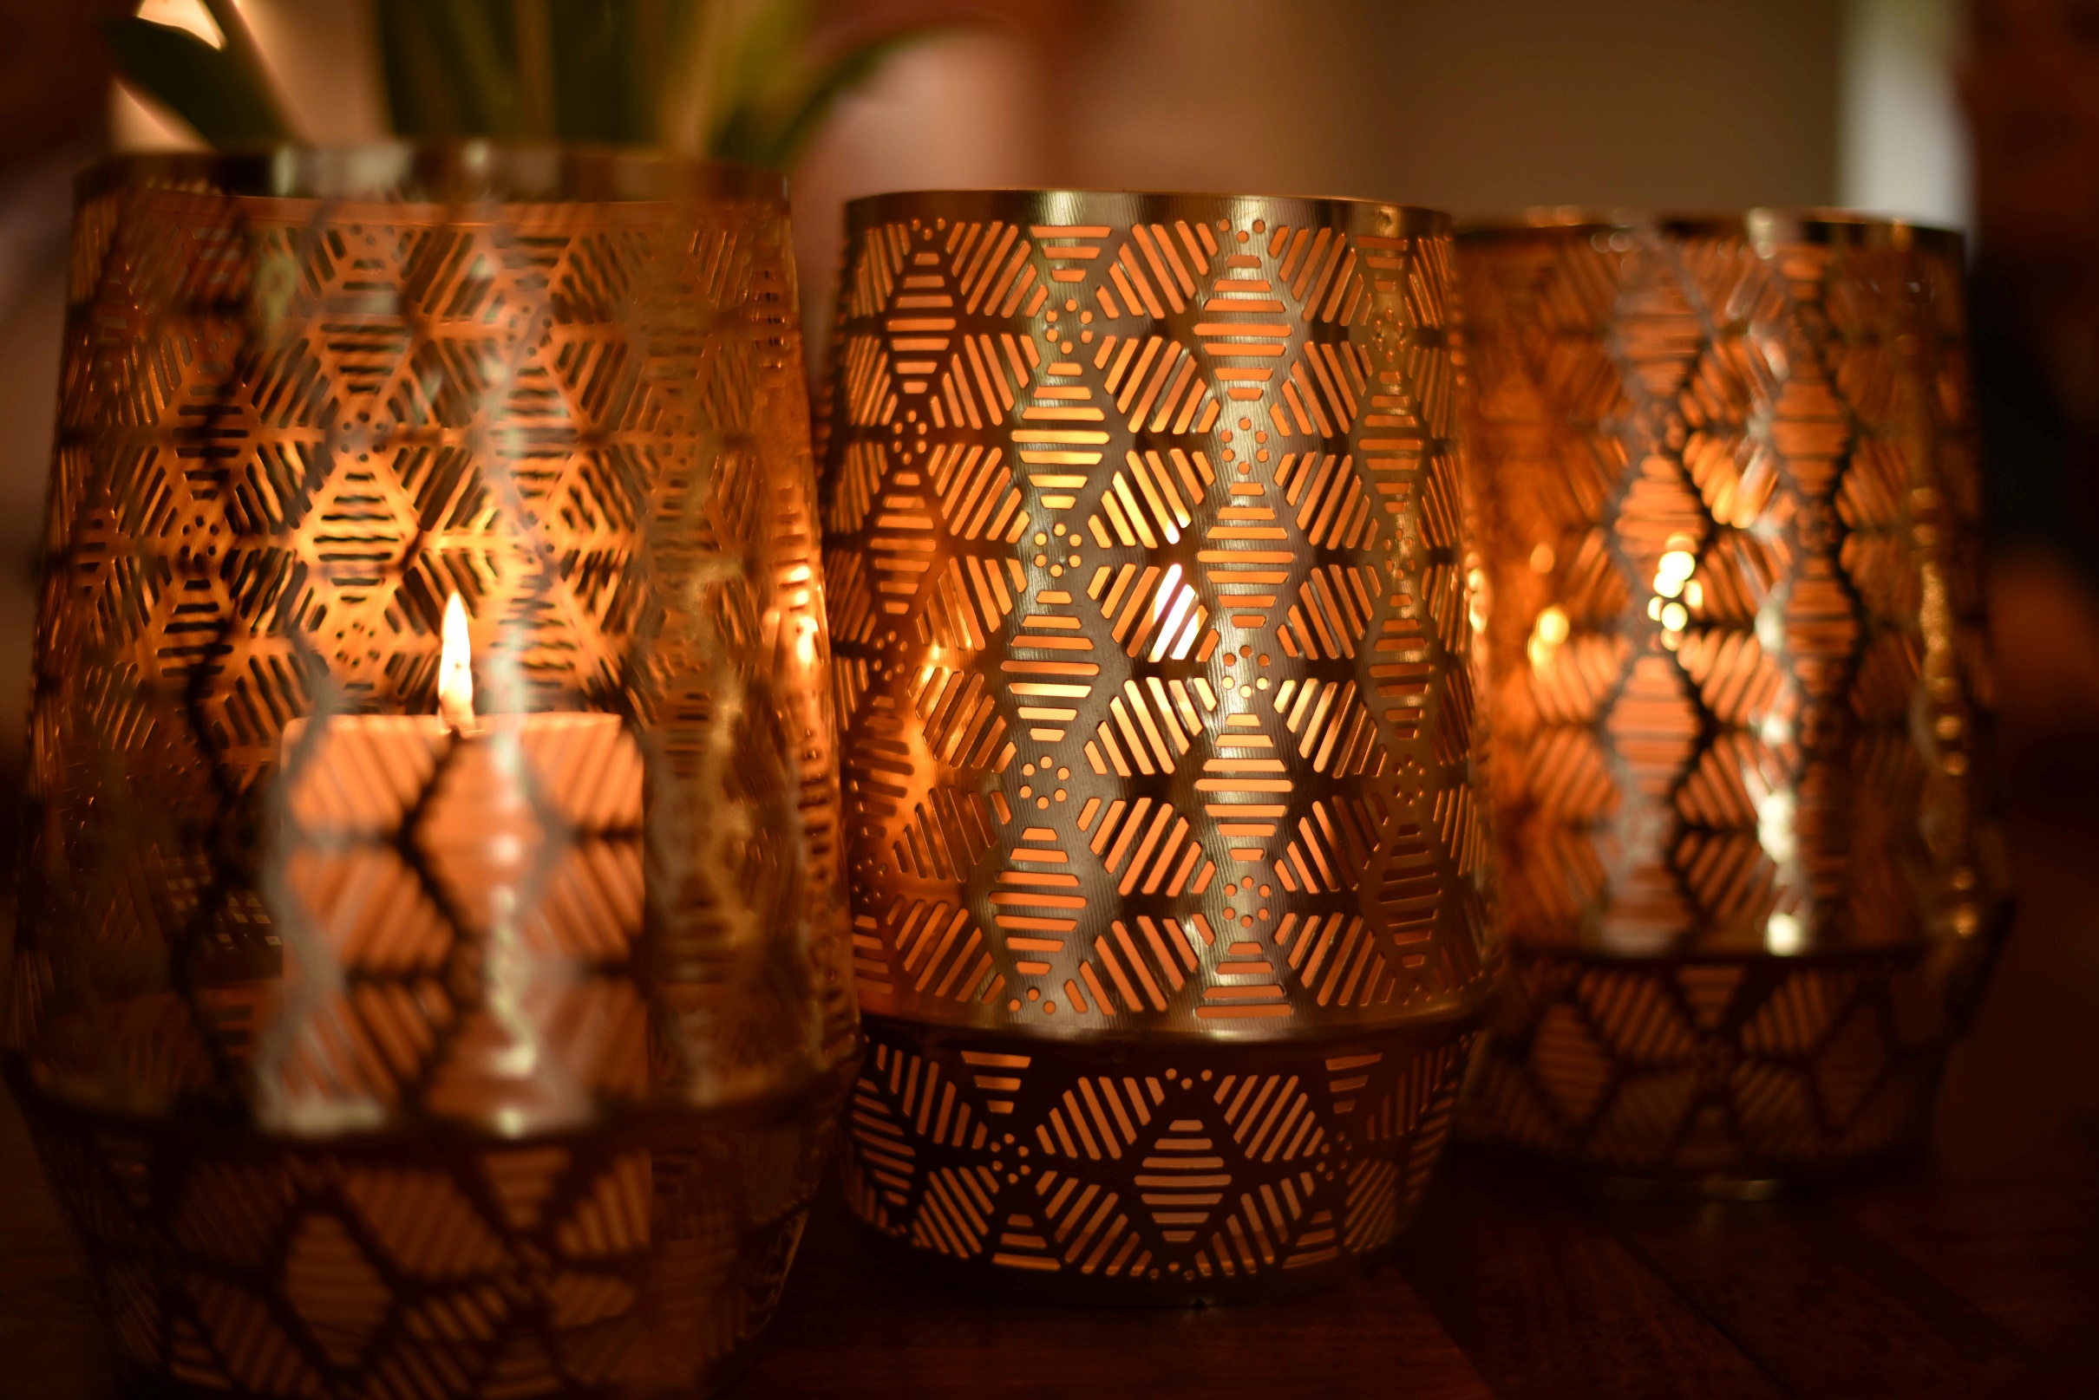

HISTORY OF BRASS
West Asian World (Early)
Roman Development
Medieval Period(5th-15th Century)
Post-Medieval (15th-17th Century)
Modification of Brass(After 17th century)

Slide 3
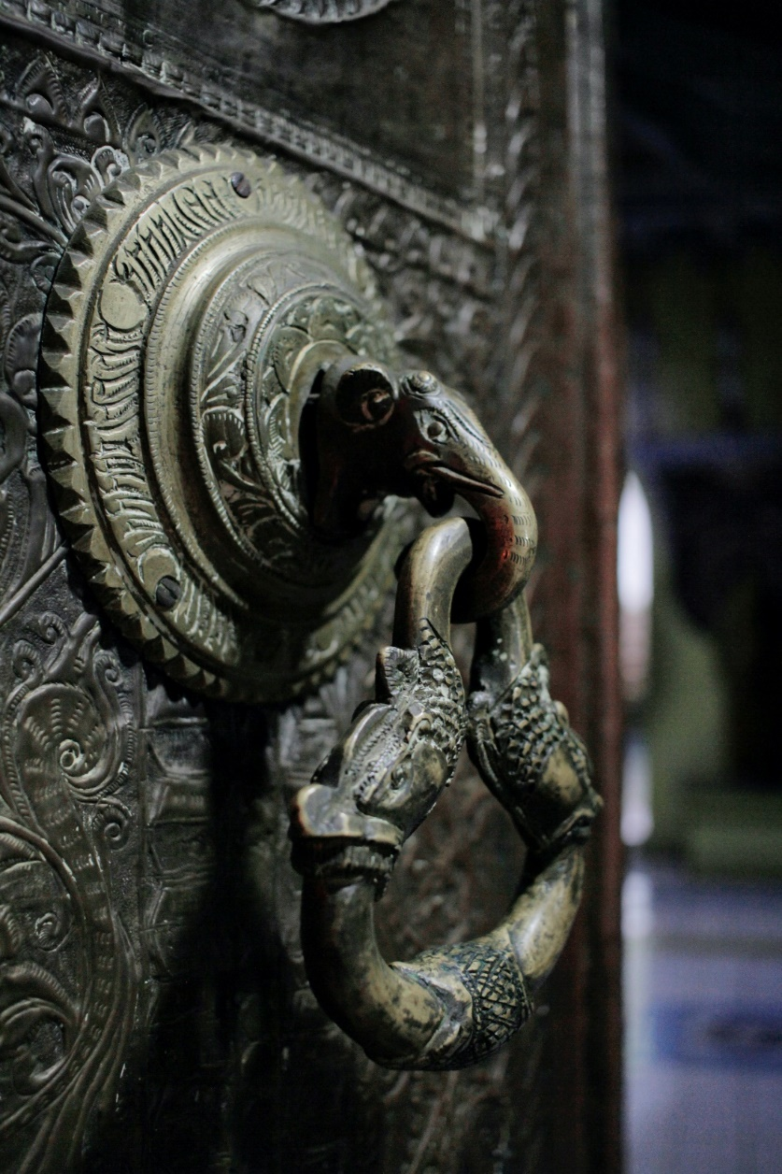
West Asian World :
In King James Bible, there are many references to “Brass” to translate “Nechoseth” from Hebrew.
In West Asia, early Cu-Zn alloy are now know in small numbers in 3rd millennium BC sites in Iraq, UAE and Turkmenistan etc.
In 2nd millennium, West India, Iran, Syria and Canaan knew about Cu-Zn alloy.

Slide 4
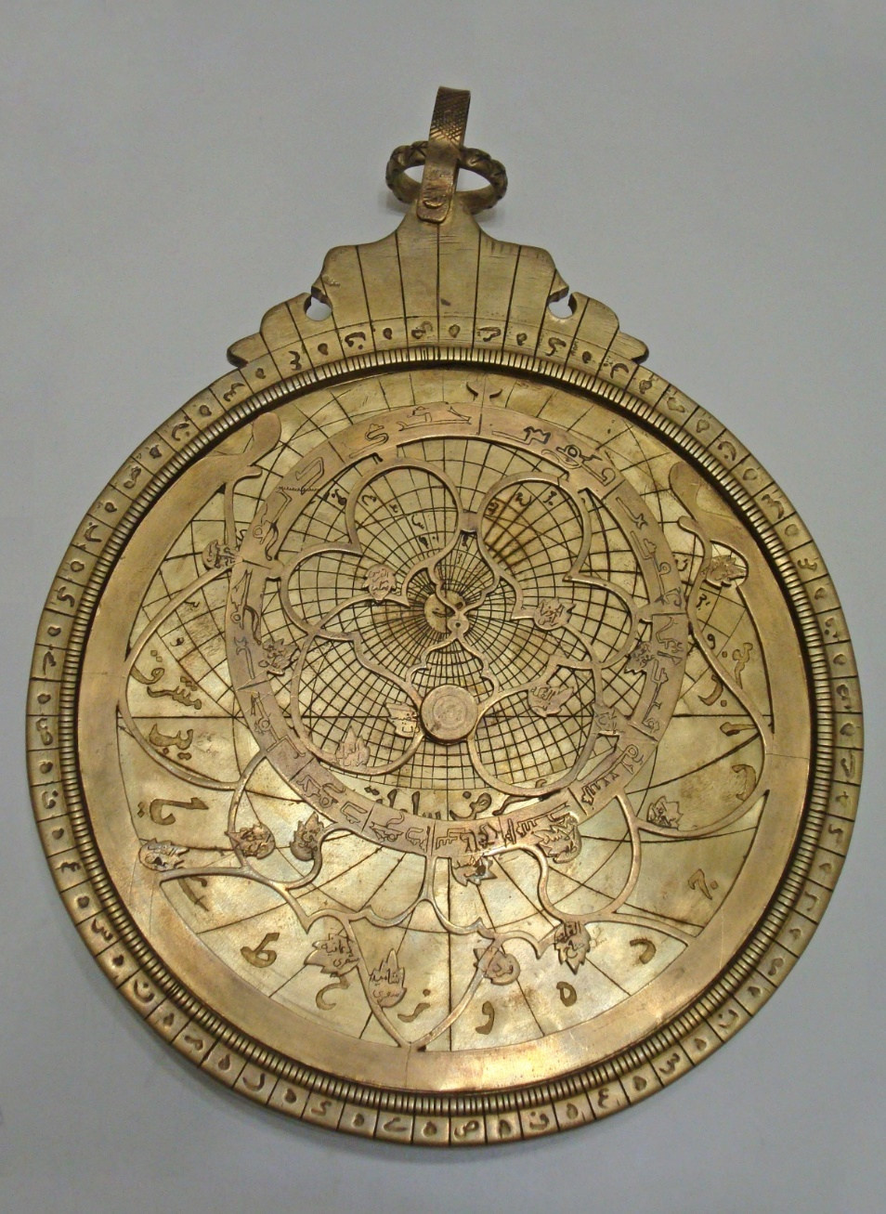
This percentage of Zn(5%-15%) is lower than in brass produced by Cementation (Cu and Zn ores are heated until Zn-vapour is produced which reacts with Cu).
This is produced by smelting of Zinc rich Copper ores in redox conditions.
Some thought, it is accidental due to some content of tin.
But large no. of Cu-Zn alloy shows that it is deliberately manufactured and gives golden colour due to zinc (12%).

Slide 5
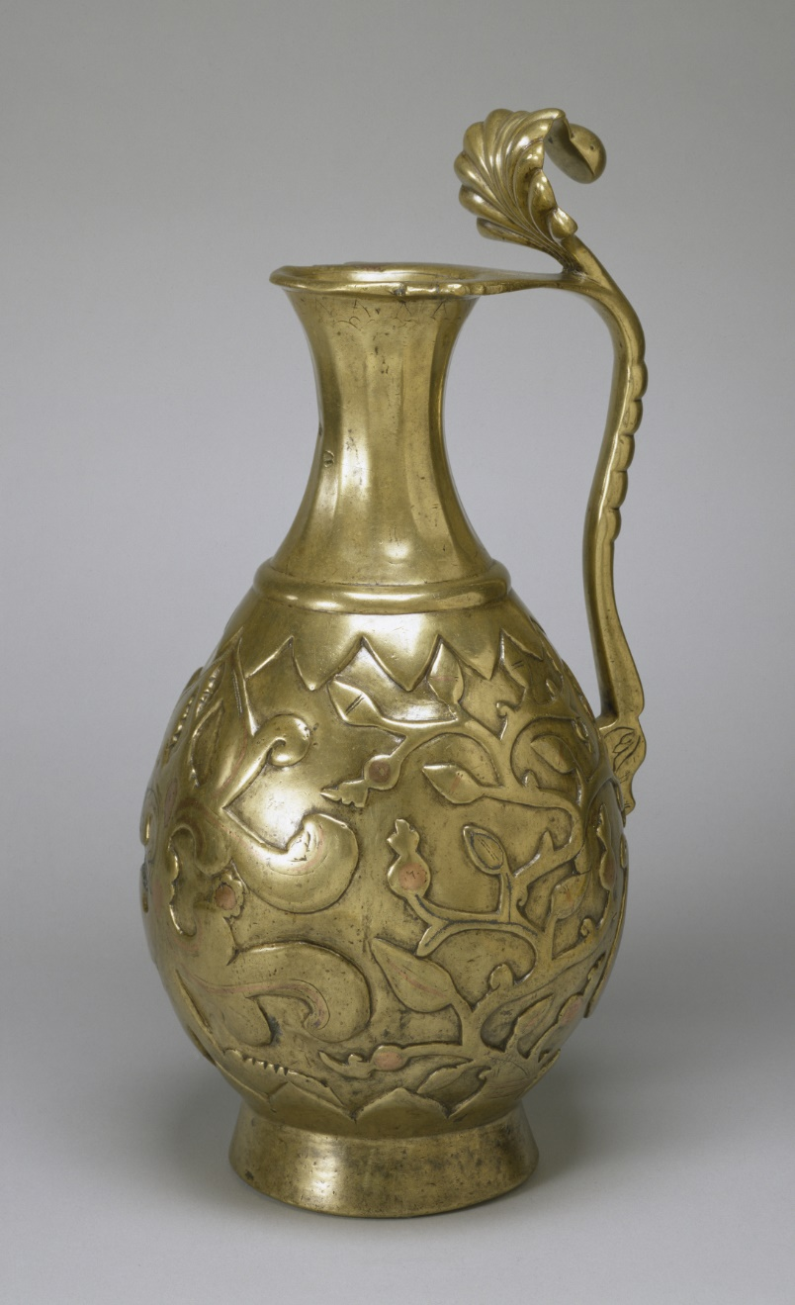
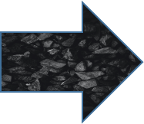
Roman Development :
In 1st millennium, use of brass spreads wide geographical areas from Britain and Spain, in Iran and India from East.
Now, brass has been encouraged by export and influence from Middle East where brass produced from metallic Cu and Zn ores.
By the 1st Century BC, brass was available in sufficient supply for Coinage.
After 23 BC, it was also used to make Roman “dupondii” and “sesterii”.
Persian Ewer of Brass

Slide 6
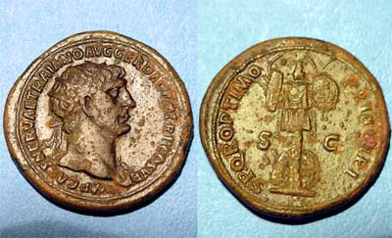
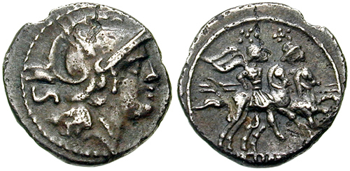
Dupondius is brass coin in Roman Empire valued as 2 asses
Sesterius was incient large brass coin on Special occasion
Roman increase the use of brass for coinage and military equipments .But,
Brass seems deliberately boycotted by Jewish due to Roman authority.
Brass was produced by cementation found on roman period of sities including Xante and Nidda in Germany and France.
Dioscorides mentioned that zinc minerals were used for both working and finishing of Brass.
Early Roman period seems to have 20%-28% zinc by weight in brass, which was declined after 1st century and made some changes in composition.
Overall the use of brass increase about 40% in roman world by the 4th century AD.

Slide 7
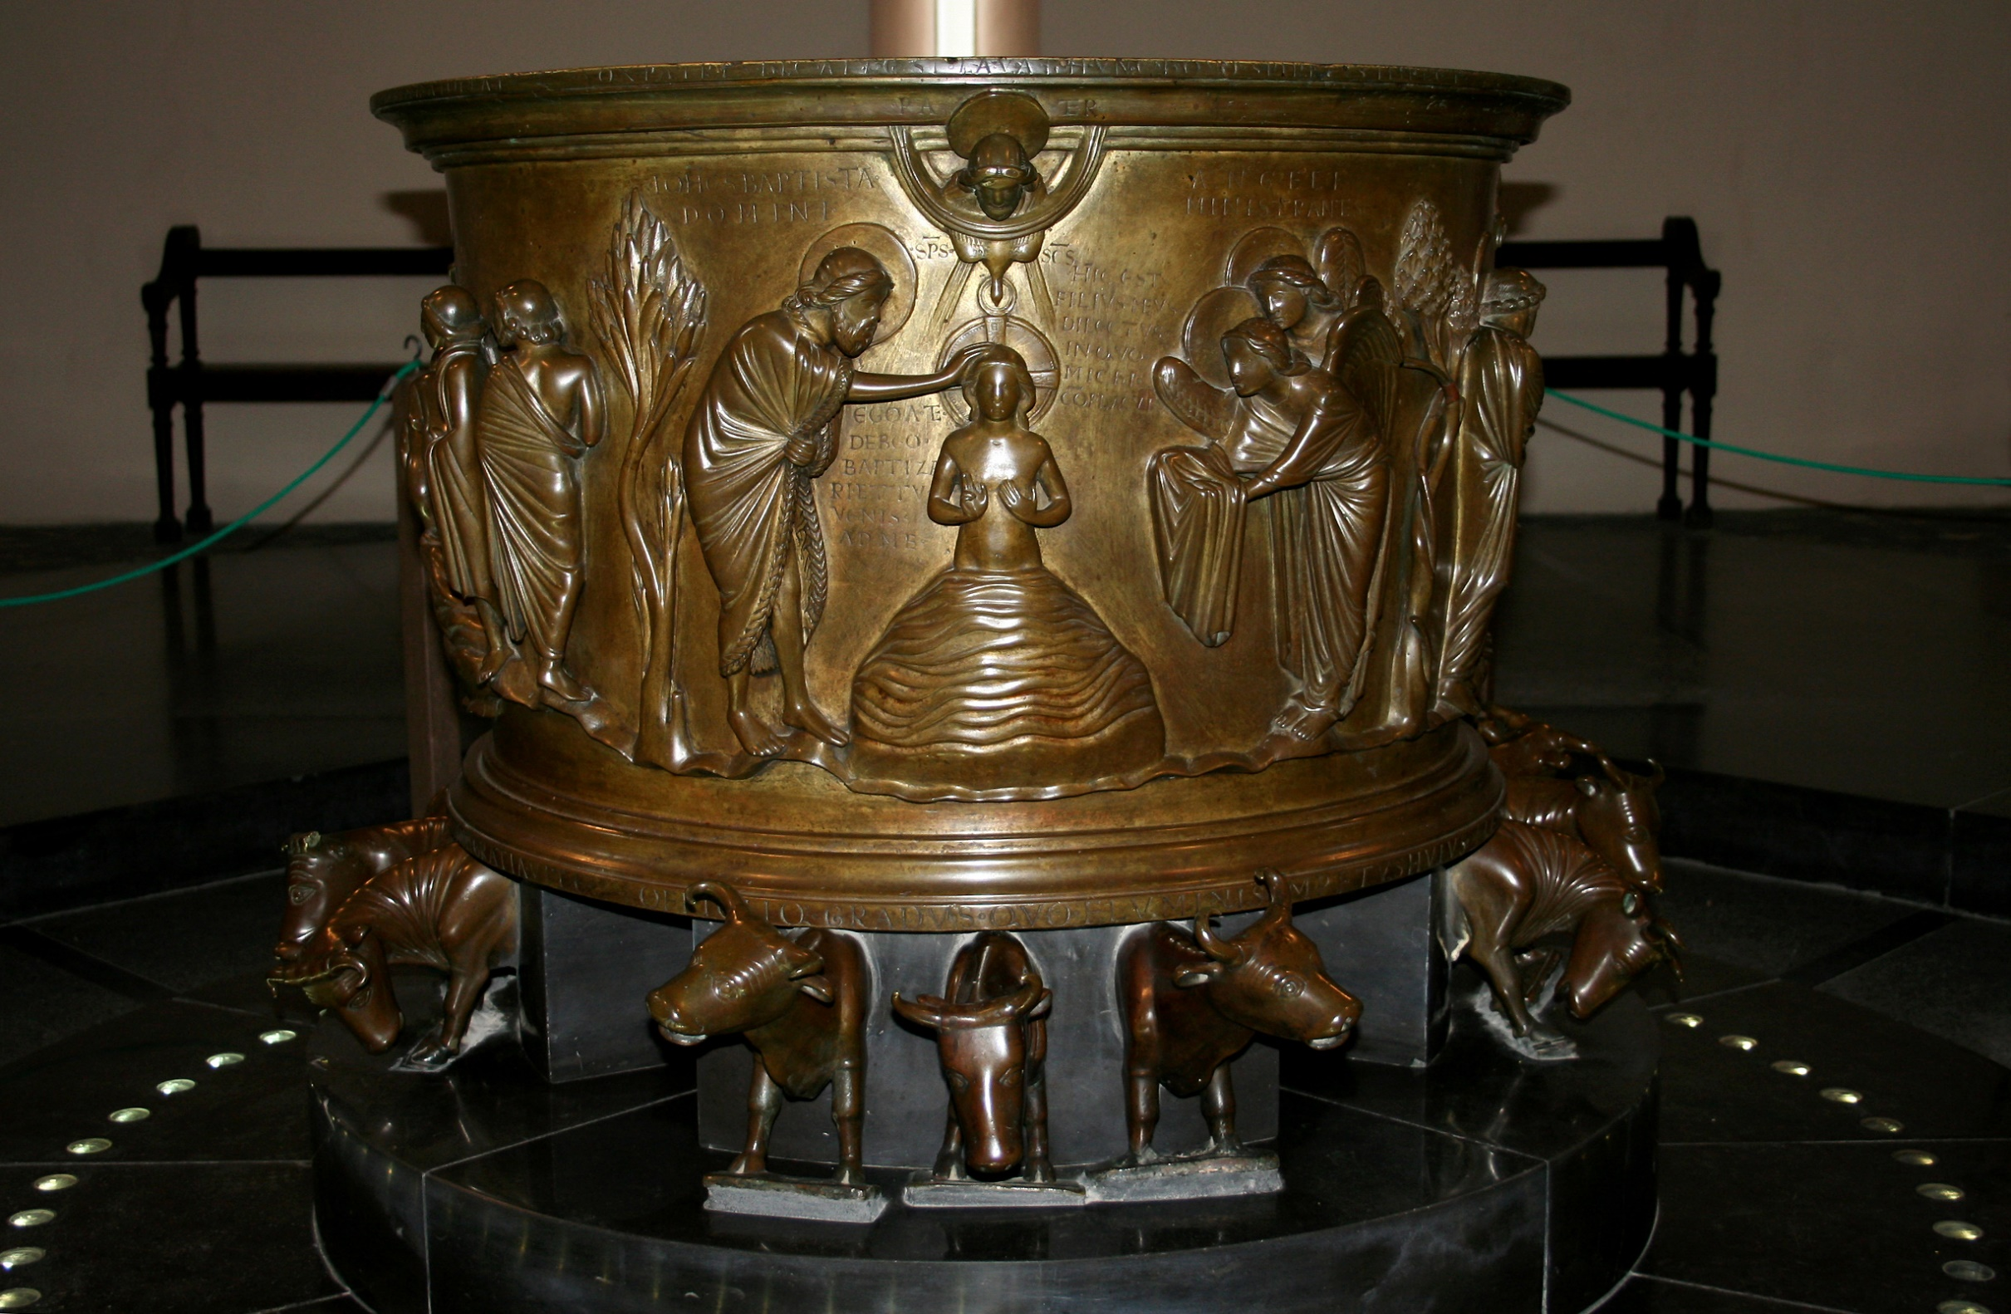
Medieval Period(5th-15th):
After collapse of Roman Empire, trade of Tin for Bronze disrupted from west Europe may have contributed in increasing popularity of Brass.
By 6th-7th centuries AD, over 90% of Cu-Alloys artefacts from Egypt were made of Brass.
Use of Brass especially increased in Islamic and Byzantine World.
The Baptismal font at St Bartholomew’s Church and Gloucester Candlestick are the unusual masterpieces of brass in 12th century.
Baptismal Font of Saint-Bartholomew’s Church

Slide 8
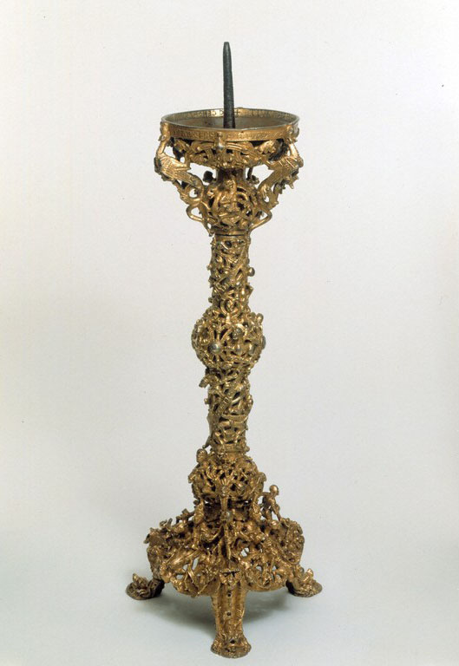
Islamic Cementation seems to have used Zinc Oxide known as Tutiya or Tutty rather than Zinc ore for Brass making, resulting in metal with low iron impurities.
In 13th century AD, Marco Polo described how this was obtained by Sublimation from Zinc ores and condensed onto Clay identified at Kash (Iran).
Yemen al-Hamdani described how Al-iglimiya used ZnO onto surface of molten Cu which produced tutiya-vapours and then reacted with metal.
In 13th century, Albertus Magnus or Saint Albert the great (known as Doctor Universalis) suggested influence from Islamic technology.
Gloucester Candlestick

Slide 9
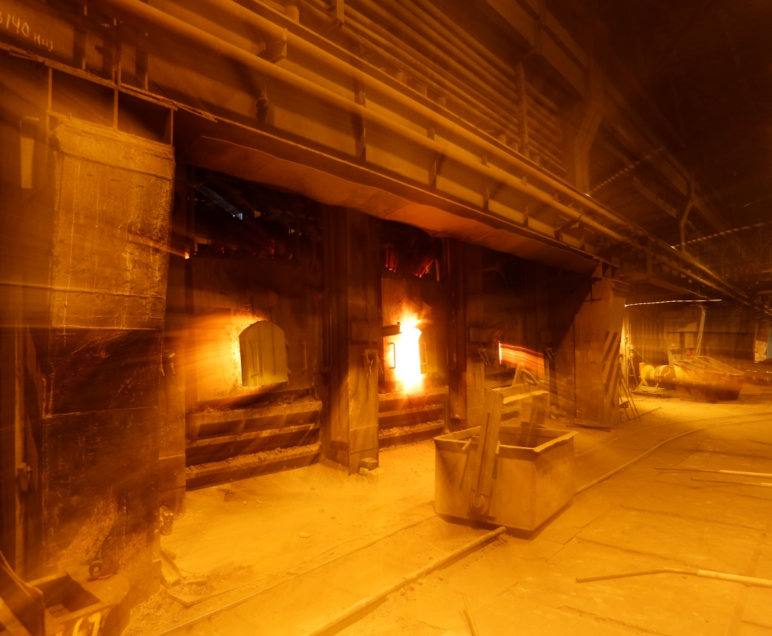
Post-Medieval Period(15th-17th):
The Renaissance(15th-16th) saw important changes to theory and practice of brass making in Europe.
In 16th century, technical writers such as Biringuccio, Ercker and Agricola described variety of cementation brass making techniques and came closer to understand the nature of Brass.
During 16th and 17th centuries, the brass industry was also established in England for take advantage of abundant supplies of cheap Cu smelted in new coal fired Reverberatory Furnace.
Reverberatory Furnace at UMMC Russia

Slide 10
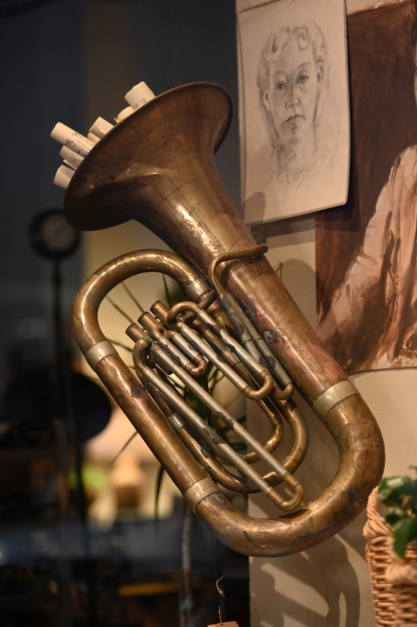
Modification(After 17th Century):
In 1723, Brass maker Nehemiah Champion reported new technique.
In 1738, Nehemiah’s son William Champion patented new technique for 1st industrial scale Distillation of metallic Zn known as “Distillation per descencum” or “the English process”.
In 1746, German Scientist named Andreas Sigismund Marggraf identified Zn and determined its properties.
The process for combining metallic Cu and Zn to make brass was patented in England in 1781.
Brass artfact of 19th Century
Notes:
1- Nehemiah = Cu produced by pouring molten metal into cold water which increase surface area of Cu and help it to react and Zn content of up to 33% wt.
2-Distillation, process involving the conversion of a liquid into vapour that is subsequently condensed back to liquid form.

